Slide 1
TrialGPT:
End-to-end patient-to-trial matching with LLMs
Jin et al. (2024), Nature Communications 15: 53081
Nathan Gin
11/24/2025
MONTH YEAR
Notes:
Hello everyone, I’m Nathan Gin, and today I’ll be presenting TrialGPT: End-to-end Patient-to-Trial Matching with Large Language Models, published in Nature Communications in 2024.
In this presentation, I’ll describe the motivation behind using AI for clinical trials, walk you through the TrialGPT system, explain its statistical and clinical relevance, and evaluate its performance from both an AI perspective and a clinical trials methodology perspective — including randomization, blinding, sample size, bias, and validity. I’ll also cover the main limitations and trust considerations of large language models in medical decision support.

Slide 2
Motivation: Why This Matters
Eligibility criteria are long, complex, and unstructured
Manual screening is slow (weeks) and inconsistent
Recruitment delays lead to underpowered trials & protocol amendments
Eligibility errors threaten internal validity even if randomization is perfect
Notes:
To start, let’s briefly summarize why eligibility screening matters so much in clinical trials. Randomized controlled trials rely on strict inclusion and exclusion criteria to ensure that the study population is well-defined and appropriate for evaluating treatment effects.
However, these criteria are usually long, complex, and written in unstructured text. Patient records — especially electronic health records — are similarly unstructured, noisy, and inconsistent.
Manual eligibility screening is time-consuming and highly variable across sites and across individual coordinators. Importantly, randomization only balances groups if the right patients are enrolled. If eligibility screening is inconsistent, biased, or simply incorrect, then even perfect randomization cannot fix the systematic differences between treatment arms.
This is one of the biggest threats to internal validity in modern trials.

Slide 3
Recruitment Bottleneck in Clinical Trials
~80% of trials fail to meet enrollment timelines
~25–30% of cancer trials fail due to insufficient enrollment
Manual chart review is labor-intensive and varies by coordinator
Eligibility misclassification introduces selection bias
Notes:
The recruitment step requires matching each patient’s clinical profile to dozens or even hundreds of eligibility criteria written in free text. These criteria are long, nuanced, and variable across trials—one may say ‘no uncontrolled hypertension,’ another might say ‘exclude systolic BP >160,’ and another may imply the same thing indirectly. Patient notes are also unstructured, written by different clinicians in very different styles. Today, trial coordinators manually read all these documents, which is slow, inconsistent, and prone to human error. This creates major delays and biases in clinical research.
One important point is that even though randomization is the gold standard for creating comparable treatment groups, it only comes into play after recruitment. Randomization cannot fix the biases introduced earlier if the enrolled population is not representative or if key patient groups are missed. In other words: randomization ensures fairness within the trial, but recruitment determines fairness into the trial. TrialGPT focuses on this upstream part, improving how we identify eligible participants before any randomization occurs.

Slide 4
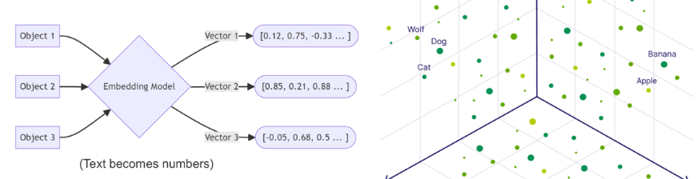
Why Use AI for Trial Matching?
Need automation for scale (> 20,000 active trials in U.S.)
Traditional keyword systems miss context (e.g., “high blood sugar” ≠ “hyperglycemia”)
LLMs capture synonyms, reasoning, and cross-criterion logic
LLMs reason over full patient notes lead to better recall, fewer missed eligible patients
LLMs can explain predictions and highlight relevant evidence sentences
More consistent screening leads to reduced selection bias and better external validity
Notes:
There are over twenty thousand active clinical trials in the United States alone, and every one of them requires detailed eligibility screening. Traditional tools like keyword search or rule-based systems don’t work well, because clinical language is messy. A phrase like ‘high blood sugar’ may never match ‘hyperglycemia’ unless the system understands medical synonymy and context.
Large language models, however, encode text into vectors—numerical representations—where similar meanings are close together in the embedding space. That means they can capture synonyms, medical reasoning, temporal expressions like ‘recent’, and even multi-criterion logic such as ‘history of’ versus ‘active disease’.
This leads to much better recall, which is critical: missing an eligible patient is a self-inflicted selection bias that harms generalizability. LLMs can also explain their decisions by pointing to specific sentences in the patient record, something traditional systems can’t do.
So AI isn’t used here for prediction alone—it’s used for scalable, interpretable, and consistent clinical reasoning across thousands of trials.

Slide 5
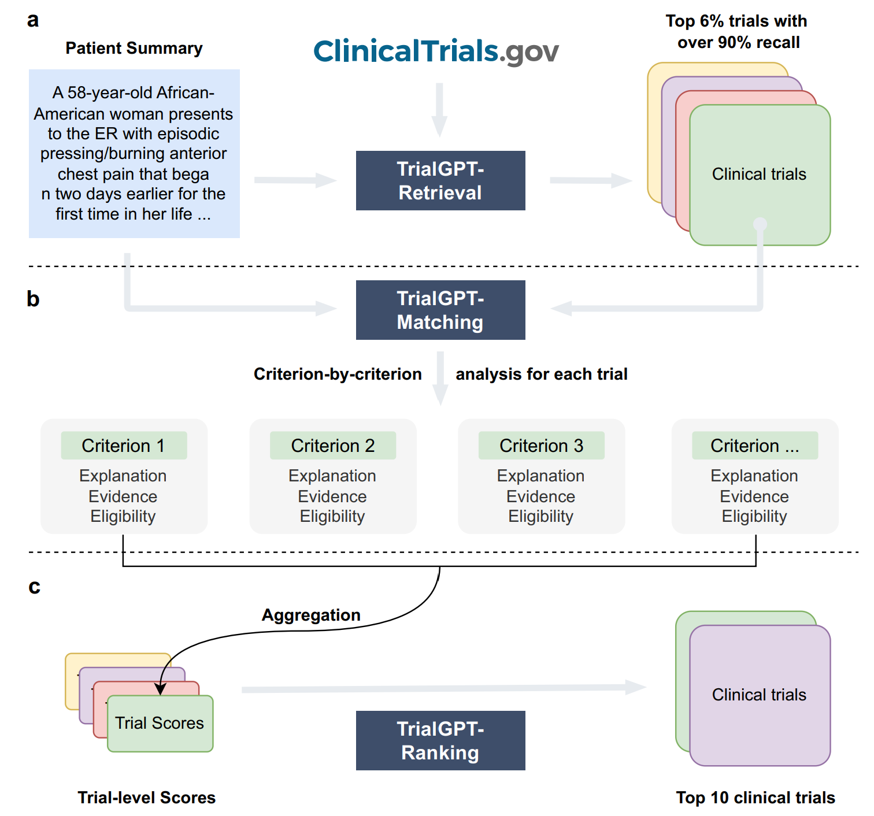
TrialGPT Architecture and Modules
3-stage pipeline:
Stage 1: Retrieval — Narrow down ~20,000 trials to a candidate set
Stage 2: Criterion-level Matching — Evaluate patient note against each inclusion/exclusion rule
Stage 3: Trial-level Ranking — Aggregate scores (inclusion/exclusion/relevance) to produce final ranking
Uses structured + chain-of-thought prompting to generate explanations
Uses GPT-4 for reasoning over clinical text
Notes:
TrialGPT is built as a three-stage pipeline that mirrors the way a clinical coordinator screens patients, but at scale and with much more consistency.
In Stage 1, Retrieval, the model takes a free-text patient note and efficiently pulls a small subset of potentially relevant trials from ClinicalTrials.gov. It reduces a search space of over twenty thousand active trials down to a focused candidate set while maintaining over 90% recall.
In Stage 2, Criterion-level Matching, the model goes through each inclusion and exclusion criterion one by one—just like a human reviewer would. For each criterion, it generates three things: an eligibility label, an explanation, and evidence sentences directly extracted from the patient note. This step is what gives TrialGPT both its interpretability and clinical practicality.
In Stage 3, Trial-level Ranking, all criterion-level decisions are aggregated into overall trial scores. This lets TrialGPT produce a ranked list showing which trials the patient is most likely eligible for.
The entire pipeline is end-to-end and runs on GPT-4, which is responsible for understanding clinical text, recognizing synonyms, and performing medical reasoning. The key advantage is that the model doesn’t just output a decision— it shows its work in a way that clinicians can verify.

Slide 6
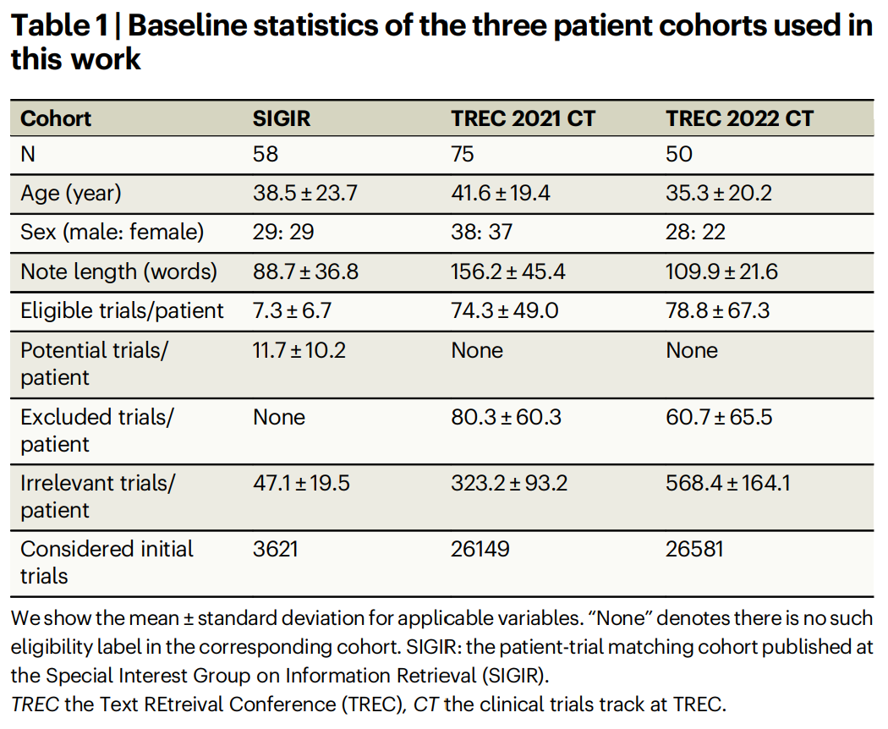
Evaluation Data and Study Design
Public benchmark cohorts from prior patient-trial retrieval tasks:
SIGIR 2016 (n = 58, short clinical notes)
TREC 2021 CT (n = 75, long oncology notes)
TREC 2022 CT (n = 50, high-complexity trials)
~75,000 patient–trial pairs manually labeled for eligibility: eligible, excluded, or irrelevant
These datasets simulate real clinical screening: each patient must be compared against hundreds of candidate trials.
Notes:
To evaluate TrialGPT, the authors used three established patient–trial matching datasets from SIGIR and TREC. These are widely used benchmark cohorts in information retrieval and clinical NLP, and they differ in note length, disease types, and trial complexity. SIGNIR 2016 contains short ER-style notes, whereas the TREC 2021 and 2022 clinical trials tracks contain much longer and more complex oncology notes.”
“Across these cohorts, there are roughly seventy-five thousand patient–trial annotation pairs, each labeled as eligible, excluded or ineligible, or irrelevant. This is important because eligibility decisions rely on evaluating the patient note against hundreds of trials, mirroring the real burden faced by coordinators.”
“These benchmark datasets serve as the first phase of evaluation: they provide controlled, labeled data where TrialGPT’s recall, ranking quality, and criterion-level explanations can be validated before moving to the prospective physician user study.

Slide 7
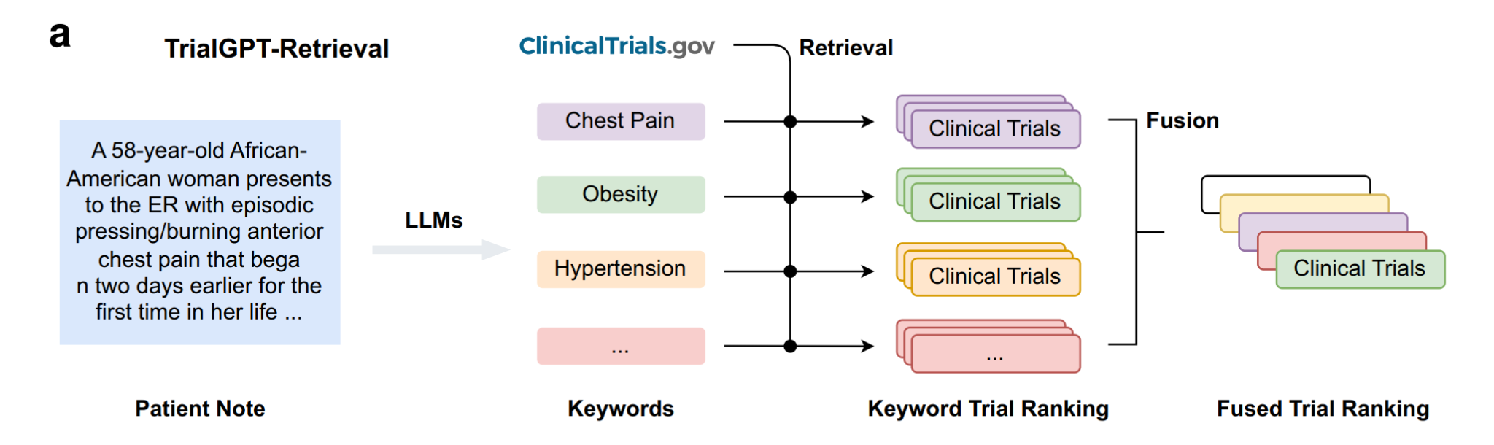
TrialGPT-Retrieval: Finding Relevant Trials
LLM generates keywords from patient note (up to 32)
Hybrid retrieval = BM25 (lexical) + MedCPT (semantic) → Reciprocal Rank Fusion
Narrows from ~20,000 trials to ~1,000 candidates
Only 5.5% of database needed to capture 90% of relevant trials
High recall ensures relevant trials are not lost
Notes:
This slide walks through the first stage of the TrialGPT pipeline: retrieval. The goal here is scale—there are roughly twenty thousand active interventional trials in the U.S., and manually searching them simply isn’t feasible.
TrialGPT begins with an LLM step where GPT-4 extracts up to about 32 clinically-meaningful keywords directly from the patient note. These are not simple bag-of-words terms; they capture diagnoses, symptoms, and synonyms like ‘hyperglycemia’ versus ‘high blood sugar,’ which traditional search engines often miss.
Those keywords are then used in a hybrid retrieval system. We combine BM25, which is a traditional lexical keyword search, with MedCPT, which is a biomedical-domain semantic embedding search. Because these two systems capture different signals, TrialGPT fuses their rankings using Reciprocal Rank Fusion, a standard IR technique that boosts agreement between the two.
This allows the model to narrow the space from around twenty thousand trials down to roughly one thousand high-recall candidates—so we only need the top five or six percent of the database to recover over ninety percent of the truly relevant trials.
This retrieval stage is crucial: if you miss a relevant trial now, no amount of matching or reasoning later can recover it. So the design choice here explicitly prioritizes recall while keeping the downstream workload manageable

Slide 8
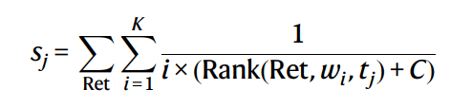
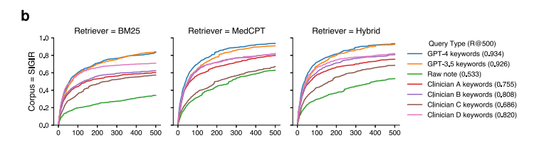
TrialGPT-Retrieval: Results
GPT-4 keywords outperform clinicians & GPT-3.5
93% recall at depth 500
Reciprocal Rank Fusion (RRF) combines BM25 + MedCPT
Ensures matching only analyzes likely-relevant trials
Notes:
Here are the retrieval results. GPT-4-generated keywords substantially outperform both clinicians and GPT-3.5, reaching about 93% recall at depth 500. That’s important because it means the system almost never misses relevant trials.
We combine BM25 and MedCPT using Reciprocal Rank Fusion, shown in the equation on the right. This gives higher weight to trials consistently ranked well by both retrievers.
The plots at the bottom show this clearly — the GPT-4 curves are consistently the highest across all datasets. The key point is that retrieval is now high-recall, so the later matching stage only needs to check trials that are already very likely to be relevant.

Slide 9
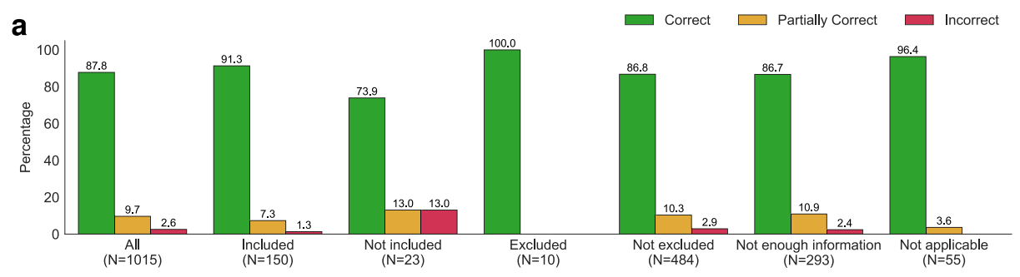
TrialGPT-Matching: Criterion-Level Eligibility
LLM reads patient note + 1 criterion at a time
Produces:
Eligibility label
Evidence sentences
Explanation (chain-of-thought)
Helps clinicians audit correctness
Notes:
Now we move into the core of TrialGPT — the criterion-level eligibility module. At this stage, the LLM takes the patient note and reads each eligibility criterion one at a time. For every criterion, it outputs three things: an eligibility label, the exact evidence sentences from the patient note, and a written explanation of its reasoning. This is important clinically because it gives coordinators something they can audit — the model isn’t a black box.”
“The figures shown here summarize human evaluation. Panel A shows overall correctness: TrialGPT’s criterion decisions are mostly correct across all categories. Panel B shows precision, recall, and F1 for three MD annotators versus TrialGPT — and the model performs in the same range as clinicians. Panel C shows confusion matrices for each annotator and for TrialGPT, again highlighting that the model is not perfect but is well calibrated and close to clinician judgment.”
“This transparency is essential because misclassifying even a single criterion can compromise internal validity. Here, TrialGPT provides both the decision and the justification, enabling clinicians to verify accuracy quickly.

Slide 10
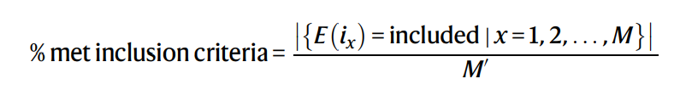
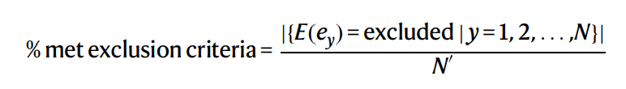
How Criterion Labels Are Produced
TrialGPT uses a cross-encoder that reads patient note + one eligibility criterion at a time
Model predicts NLI labels: entailment, contradiction, neutral
Map NLI outputs to eligibility categories:
Included = entailment
Not included = contradiction
No information = neutral
Excluded / not-excluded handled similarly for exclusion criteria
Aggregation computes:
% inclusion criteria met
% exclusion criteria triggered
General relevance score (0–100)
Eligibility score (0–100)
Notes:
Now we move into how TrialGPT actually generates eligibility predictions.
TrialGPT uses a cross-encoder—it reads the patient note together with one criterion at a time. The model outputs an NLI label: entailment, contradiction, or neutral. These are then mapped into clinical eligibility outcomes.
For inclusion:
Entailment → Included
Contradiction → Not included
Neutral → No information
Exclusion criteria work the same way.
Once we have a label for every criterion, TrialGPT aggregates them: the percentage of inclusion criteria satisfied, the percentage of exclusion criteria violated, and two LLM-derived scoring components—the general relevance and eligibility scores.
These are combined using the paper’s equations—Eq. 14 and Eq. 25–26—to produce a single trial-level score used for ranking.

Slide 11
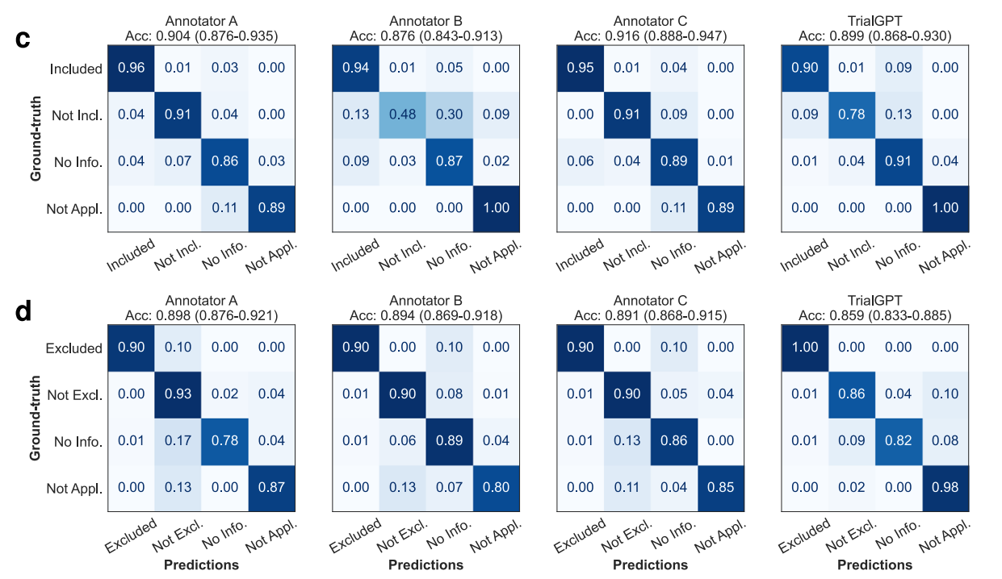
Evaluation of Criterion-Level Predictions
1,015 patient–criterion pairs manually reviewed
~90% correctness for explanations
Eligibility accuracy: ~87–89%
Evidence extraction F1 ≈ 0.90
Confusion matrices show:
Strong diagonal
Most errors come from unclear EHR text or abbreviations
Performance comparable to human annotators
Notes:
To evaluate accuracy, the authors manually reviewed 1,015 patient–criterion pairs. About 90% of the explanations were judged correct, and eligibility accuracy was 87–89%, which is very close to human annotators.
The evidence extraction step had an F1 of around 0.90, meaning the model generally highlighted the right sentences.
The confusion matrices show strong diagonal dominance, which indicates consistent classification. Most errors arise when EHR notes are ambiguous, abbreviated, or missing clinical detail—issues clinicians struggle with as well. Overall, TrialGPT performs at a level similar to trained annotators.

Slide 12
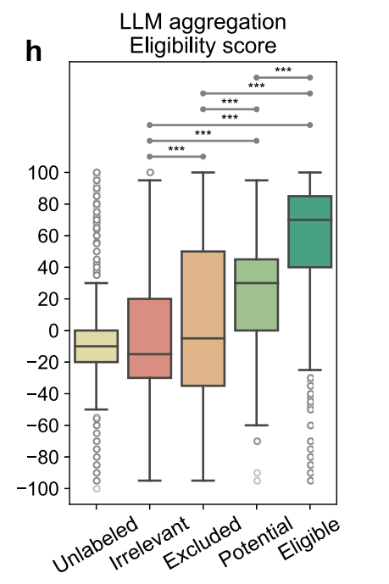
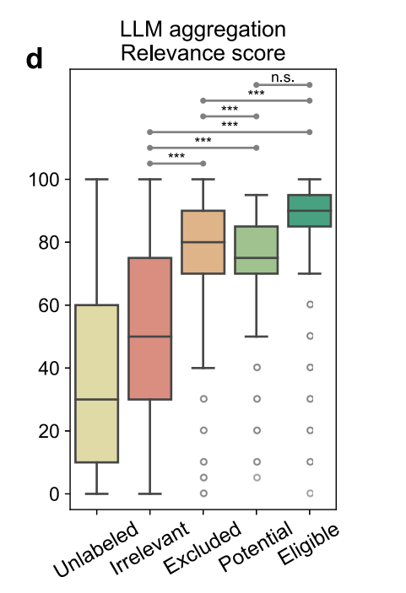
TrialGPT-Ranking: Trial-Level Aggregation
Aggregates criterion-level outputs into a single trial score
Uses two aggregation strategies:
Linear: % inclusion criteria met, % exclusion criteria triggered
LLM-based: relevance score + eligibility score (0–100)
High-scoring pairs meet most inclusion criteria and few exclusion criteria
Produces a ranked list of best-matching trials
Aggregated scores separate trial–patient pairs into:
Irrelevant
Potential
Eligible
LLM aggregation outperforms linear scoring
Notes:
TrialGPT then aggregates the criterion-level outputs to estimate how suitable each trial is overall. The authors used six different linear aggregation statistics—like the percentage of inclusion criteria met—and two LLM-based aggregation scores. Trials that a patient is eligible for tend to have high inclusion-met percentages and low exclusion-met percentages. The LLM-aggregated eligibility score was especially strong, providing a fine-grained and interpretable ranking signal across trials.
Figure 4 shows that when TrialGPT aggregates all the criterion-level predictions into trial-level scores, those scores correlate extremely well with the true eligibility labels assigned by human experts. Across all scoring methods, eligible patient–trial pairs consistently receive significantly higher inclusion and relevance scores and significantly lower exclusion scores than irrelevant or excluded pairs. This demonstrates that TrialGPT can reliably rank and score trials in a way that matches how human clinicians think about eligibility.
Panels (d) and (h) show the strongest evidence that TrialGPT’s trial-level scoring aligns with expert judgment. In panel (d), the LLM-generated relevance score clearly separates eligible trials from irrelevant or excluded ones. In panel (h), the LLM-generated eligibility score shows the same pattern: eligible pairs consistently receive the highest eligibility scores, irrelevant pairs receive the lowest, and potential matches fall in between. This demonstrates that TrialGPT can effectively aggregate many criterion-level decisions into meaningful overall scores that match clinician expectations.

Slide 13
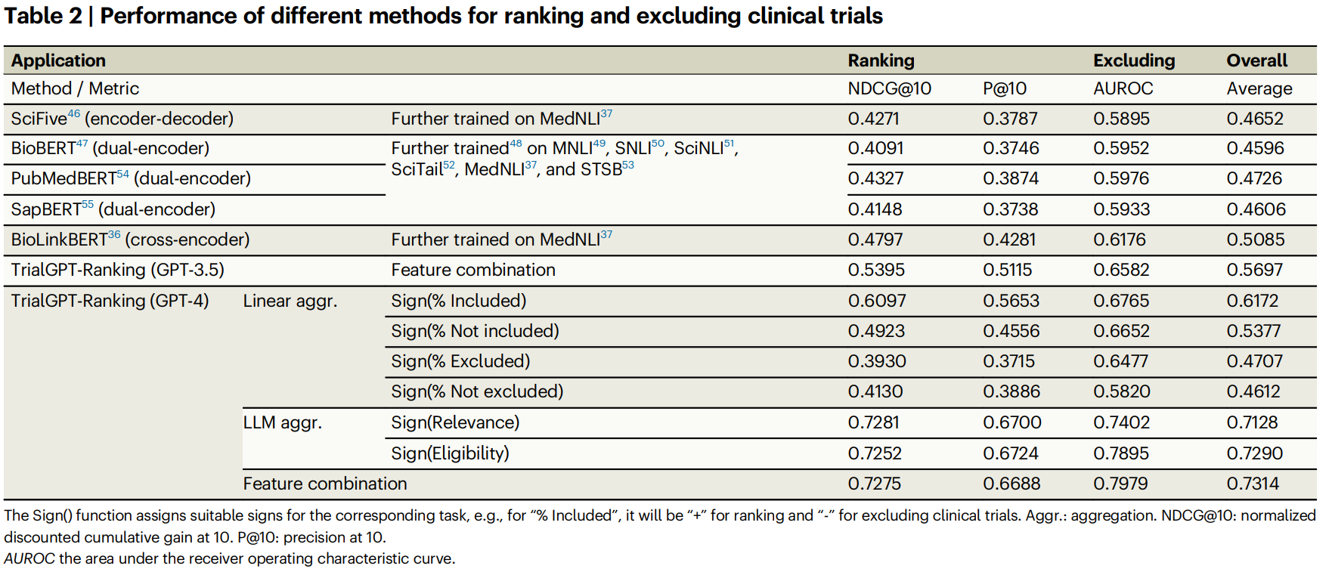
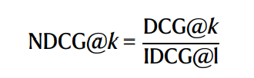
How Well Does It Work?
TrialGPT (GPT-4) vs best baseline (BioLinkBERT, MedNLI-trained):
NDCG@10: 0.73 vs 0.48
P@10: 0.67 vs 0.43
AUROC: 0.80 vs 0.62
≈44% improvement in overall ranking & exclusion accuracy
LLM aggregation (relevance/eligibility scores) outperforms linear aggregation and all encoder-decoder baselines
Strongest performance across all evaluation settings (SIGIR, TREC21, TREC22)
Notes:
Here we compare TrialGPT’s ranking performance against traditional NLP baselines, including BioLinkBERT, which is one of the best models trained on biomedical NLI data.
TrialGPT using GPT-4 substantially outperforms all baselines across three major ranking metrics. For example, NDCG@10 improves from 0.48 with the BioLinkBERT baseline to 0.73 with TrialGPT, precision at 10 improves from 0.43 to 0.67, and AUROC improves from 0.62 to 0.80.
Overall, this corresponds to roughly a 44% improvement in ranking and exclusion accuracy. Importantly, we also see that LLM-based aggregation scores outperform both linear aggregation strategies and all encoder-decoder models, demonstrating that GPT-4 captures deeper semantic relationships between patients and trials.
In other words, TrialGPT isn’t just a little better—it sets a new state of the art for patient-trial matching.

Slide 14
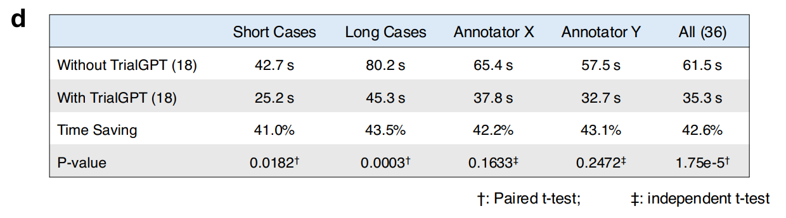
Real-World Test: Physicians with TrialGPT
6 trials × 6 patients → 36 screening tasks
Two physicians: half of tasks with TrialGPT, half without
Decision accuracy: 97% vs 92% (difference not statistically significant)
Screening time reduced by 42.6% on average
Greater savings for longer, more complex cases
Same decisions with or without AI (97% concordance)
P-values show time reduction is statistically significant (paired t-test)
Notes:
This slide summarizes the real-world pilot study where TrialGPT was tested with physicians to see whether it actually improves clinical workflow.
The study used six clinical trials and six patient notes, producing a total of thirty-six screening tasks. Two physicians completed half the tasks with access to TrialGPT and half without.
What’s important is that the final screening decisions were essentially the same with or without AI—97% concordance—and the accuracy difference, 97% versus 92%, was not statistically significant. This shows TrialGPT does not change the clinical judgment; rather, it assists it.
However, TrialGPT made a major difference in efficiency. Screening time dropped by 42.6% on average, and the effect was even larger for long, complex cases. For example, long cases went from 80 seconds to 45 seconds. The p-values in the table show these improvements are statistically significant.
The key takeaway is that TrialGPT preserves clinical decision quality while substantially reducing screening time, which is exactly the bottleneck in real-world trial recruitment.

Slide 15
Randomization & Blinding
TrialGPT is used before randomization
Standardizes eligibility assessment → stronger internal validity
Blinding preserved (AI sees no treatment-arm info)
Reduces systematic eligibility bias across sites
Eliminates coordinator-to-coordinator variability
Notes:
This is important from a clinical trials perspective. TrialGPT operates before randomization, meaning it helps determine who is eligible without ever touching treatment-arm information. This preserves blinding and eliminates any chance that eligibility decisions could leak treatment hints or introduce allocation bias.
Because TrialGPT applies eligibility criteria the same way every time, it strengthens internal validity and prevents site-level variability. In multi-site trials, this can reduce systematic differences that creep in when coordinators interpret criteria differently.

Slide 16
Statistical Considerations
Better screening → more accurate:
Event-rate assumptions
Dropout projections
Screen-failure rates
Other benefits:
Reduces eligibility misclassification error
Improves power calculations (fewer screen failures)
Criterion-level outputs allow sensitivity analyses (e.g., impact of mislabeling one criterion)
Notes:
TrialGPT’s improvements to eligibility screening translate directly into better statistical properties for a trial. When eligibility is applied more consistently, estimates of event rates, dropout projections, and screen-failure rates become more accurate. These quantities are central to sample-size calculations.
TrialGPT also reduces misclassification error. Incorrectly enrolling or excluding patients is a major source of variance inflation. Finally, because TrialGPT produces criterion-level labels, we can analyze how sensitive results might be to misinterpretation of specific eligibility criteria — something manual screening never allowed.

Slide 17
Bias and Limitations
Data limitations
Synthetic cohorts → uncertain external validity
Domain shift across institutions
Demographic under-representation
Model limitations
Dependence on GPT-4
Hallucination risk
Knowledge gaps in rare conditions
Annotation & documentation issues
Ambiguous criteria → noisy labels
Variability in EHR documentation
Ethical considerations
Transparency & explainability
Bias propagation
Need for human oversight
Notes:
There are also important limitations. First, the evaluation uses synthetic cohorts, so external validity is uncertain, and domain shift across institutions may impact performance. Second, TrialGPT depends on GPT-4, which introduces potential hallucination risk and weaknesses in rare conditions.
We also need to consider annotation noise — human labels for eligibility criteria are themselves imperfect — and variability in EHR documentation.
Finally, there are ethical concerns. Without transparency and human oversight, LLM systems may propagate bias or produce opaque decisions. These limitations highlight the need for careful deployment.

Slide 18
Practical Impact & Future Directions
Faster enrollment → fewer protocol deviations
Standardized eligibility screening across sites
Enhances support for adaptive and platform trials
Potential integration with:
Multimodal inputs (EHR + imaging + labs)
Prospective clinical evaluation
Smaller, domain-specific medical LLMs
Workflow automation in trial centers
Notes:
TrialGPT can meaningfully accelerate enrollment by reducing screening time and screen failures, which in turn reduces protocol deviations and trial delays. It standardizes eligibility screening across sites, which is essential for large multi-center trials.
Looking forward, TrialGPT could support adaptive or platform trials by providing real-time eligibility scoring. The authors also propose extensions to multimodal systems that integrate imaging or structured labs, prospective evaluations in real trial settings, and development of specialized open medical LLMs.

Slide 19
References
Brown, T., Mann, B., Ryder, N., Subbiah, M., Kaplan, J., Dhariwal, P., … & Amodei, D. (2020). Language models are few-shot learners. NeurIPS, 33, 1877–1901. https://arxiv.org/abs/2005.14165
Jin, Q., Yu, F., Wang, X., et al. (2024). TrialGPT: End-to-end patient-to-trial matching with large language models. Nature Communications, 15, 53081. https://doi.org/10.1038/s41467-024-53081-z
Lu, J. (2024, January 12). From PubMed to TrialGPT: Exploring the impact of AI and large language models in medicine [Video]. YouTube. https://www.youtube.com/watch?v=QwIlSA7n_ks
Robertson, S., & Walker, S. (1994). Some simple effective approximations to the 2–Poisson model for probabilistic weighted retrieval. SIGIR, 232–241.
Singhal, K., Azizi, S., Tu, T., Mahdavi, S. S., Wei, J., Chung, H., … & Natarajan, V. (2023). Large language models encode clinical knowledge. Nature, 620(7972), 172–180. https://doi.org/10.1038/s41586-023-06467-6
Notes:
Here are my references

